Slide 1
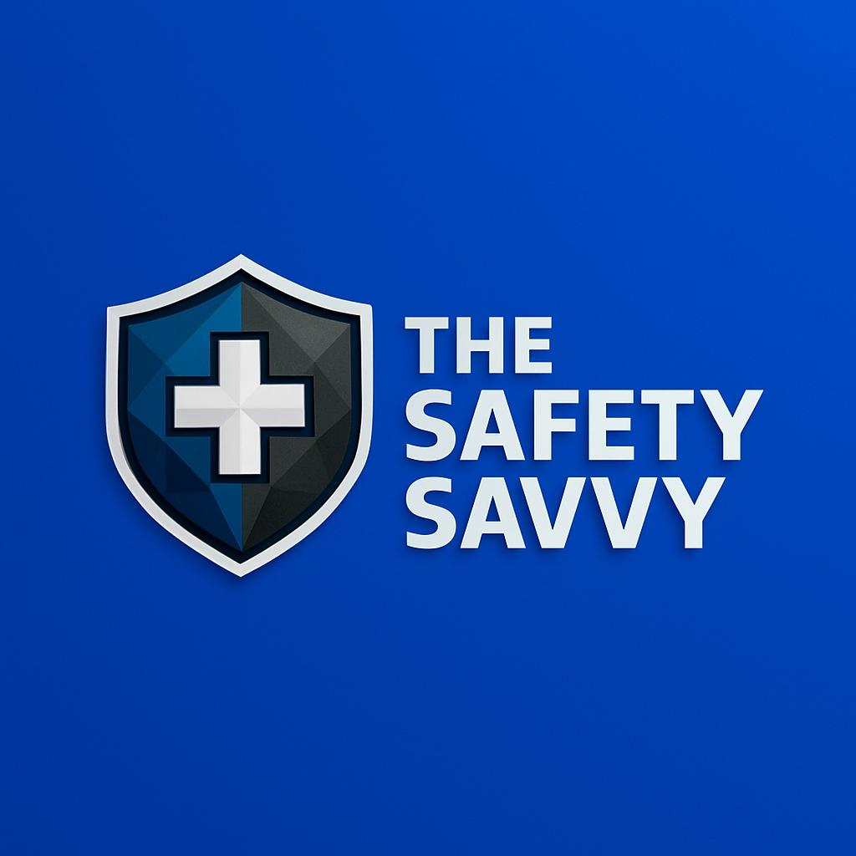

Level 2 Basic Life Support & Safe Use of an AED (RQF)
Qualification Information:
Regulated Qualifications Framework (RQF) Code: 601/5478/0
Awarding body: First Aid Awards Ltd (part of Nuco plus Training- content that The Safety Savvy ltd uses)
This Basic Life support & safe use of an AED course focuses on the core skills of CPR, using an Automated External Defibrillator (AED), and dealing with unconscious casualties. Suitable for healthcare professionals or anyone wanting life-saving training in a short time.
Course Duration:
Total:
Minimum of 4 hours.
Recommended to run over half a day.
Syllabus Topics Covered:
Conduct a primary survey to assess emergencies
Perform CPR on adults (chest compressions and rescue breaths)
Use an AED safely and effectively
Carry out a secondary assessment to monitor breathing and vital signs
Understand key emergency response steps and first aid principles
Assessment:
Summative Practical Assessments – ongoing throughout course
Written Assessment – at the end
Certification:
Successful candidates receive a Level 3 (England/N. Ireland/Wales) or Level 6 (Scotland) award
Valid for 3 years
Free digital certificate included
Group Size:
Maximum of 12 learners per course.
For groups greater than 12 an additional instructor can be added.
Pricing:
Please contact us at contact@thesafetysavy.com
Delivery:
All courses are delivered on site on your premises.

